Slide 1
BSC124 Marketing Communications (10-credits)

Slide 2
About Marketing Communications
On completion of this module, you will:
Understand the important role of marketing communications (promotions) for organisations
Know the value and importance of Integrated Marketing Communications (IMC)
Be able to analyse, assess, and evaluate Integrated Marketing Communications strategies
To understand the value of the different tools within the Marketing Communications Mix

Slide 3
Module Content
The taught material involves dynamic and exciting areas, such as:
How marketing communications work and support brands to achieve strategic goals
Marketing Communications Mix - advertising, sponsorship, public relations, sales promotions, digital marketing and personal selling
Ethical and legal issues in marketing communications
The UK Advertising sector – agencies, media and customers (a tripartite relationship)
Public Relations and press release development

Slide 4
Teaching and Learning
The module is taught as a weekly two hour lecture each week.
Lectures draw on academic material, with lots of industry examples and case studies to enrich your learning experience. Lectures generally feature:
Quizzes
Videos
Practical Examples
Discussion
Case Studies
Academic Theories & Models

Slide 5
Assessment and Feedback
The module is assessed via two pieces of assessed coursework
A group work Pitch Presentation, creating a marketing communications campaign for a real-life industry brief - 50%
An individual piece of written coursework to support your presentation (1000 words) - 50%

Slide 6
Your Skills & Knowledge Development
Studying this module will enable you to:
Enhance your knowledge and understanding of how marketing communications work, in order to design and implement a fully integrated marketing communications campaign.
Select and evaluate communication strategies which meet specific marketing communications objectives
Develop transferable skills - discussing and explaining arguments in writing, whilst collecting ideas and examples from a range of sources

Slide 7
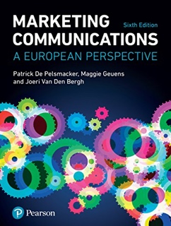
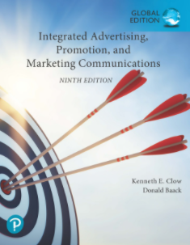
Reading Materials
This module uses TWO CORE books:
De Pelsmacker, P., Geuens, M., and Van den Bergh, J. (2018). Marketing Communications: A European Perspective, 6th Edition, Pearson Education, Prentice Hall.
Clow, K., Baack, D. (2020). Integrated Advertising, Promotion and Marketing Communications, 8th Edition, Pearson Education
In addition to these books, various other academic papers, industry sources and case studies are used to enhance learning.

Slide 8
Why choose this module?
This module offers a great mixture of theory and practice, enabling understanding of how theory applies in commercial and creative environments
The content enhances learning experience and it is enjoyable as it relates to current, real-life examples of advertising and marketing communications
For further information about the module contact Mrs Rachael Mabe – R.A.Mabe@lboro.ac.uk and I will be happy to answer any questions ☺

